Slide 1
A2J Author® 5.0 The Basics Training
Jessica Bolack Frank
Program Coordinator
Center for Access to Justice & Technology
Chicago-Kent College of Law

Slide 2
Question Design Agenda
Creating a new question in A2J Author
The Question Design Window: Where did all those tabs go?
Question Design Now: Scroll to See it All
Additional Resources

Slide 3
Creating a New Question
www.a2jauthor.org

Slide 4
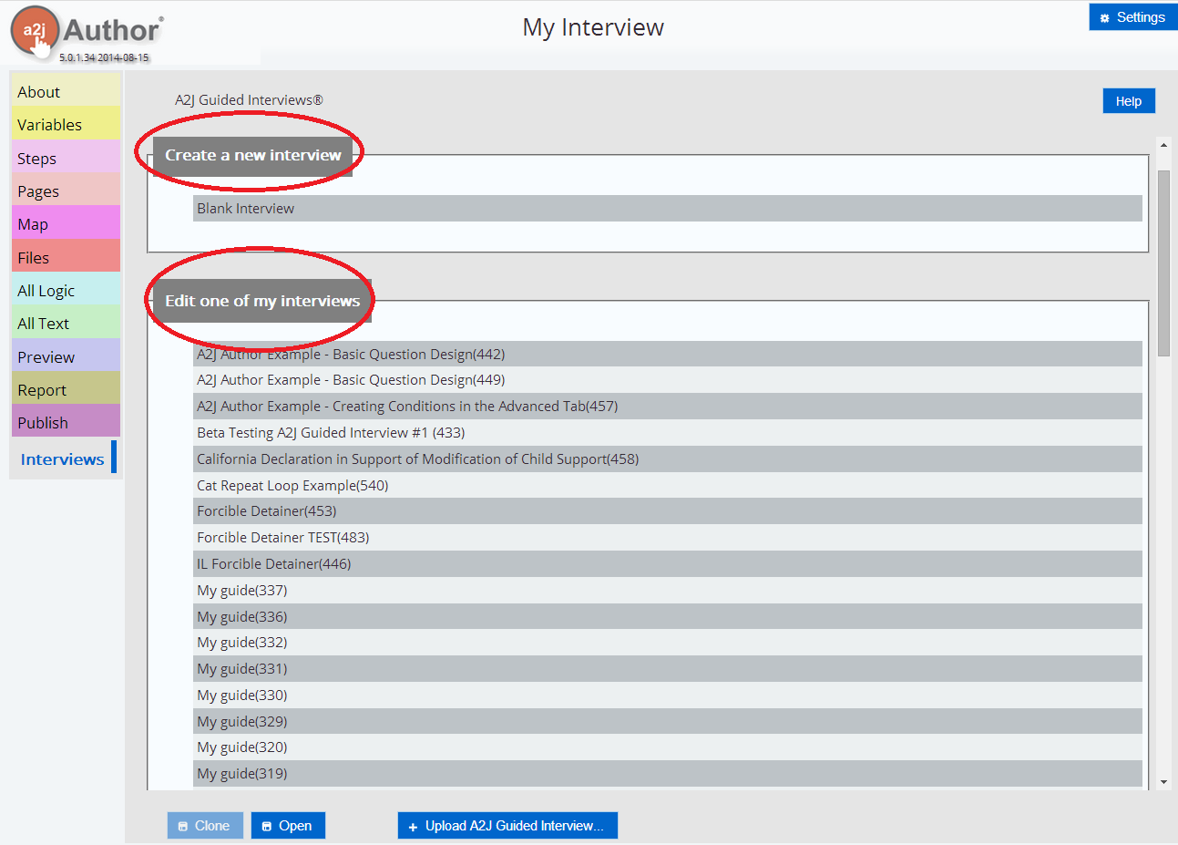
My Interviews

Slide 5
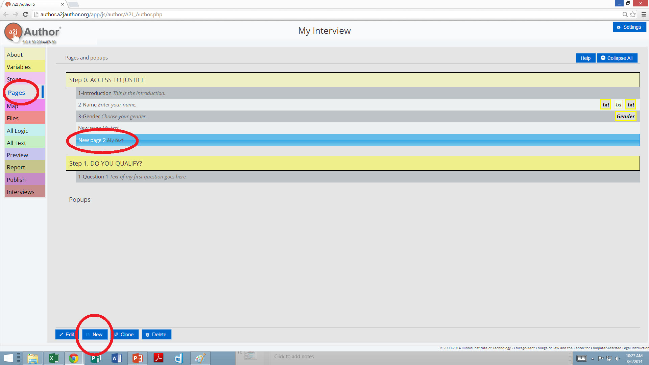
Creating New Questions
Questions appear in the interview by how they are connected to each other (see Map)
Add a new question to the default list

Slide 6
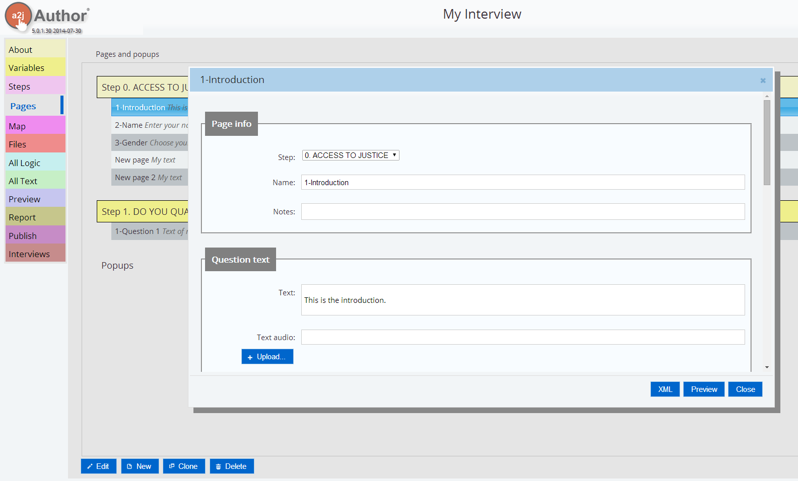
The Question Design Window: Where did all those tabs go?
Notes:
They are all combined into 1 pop up question design window now.

Slide 7
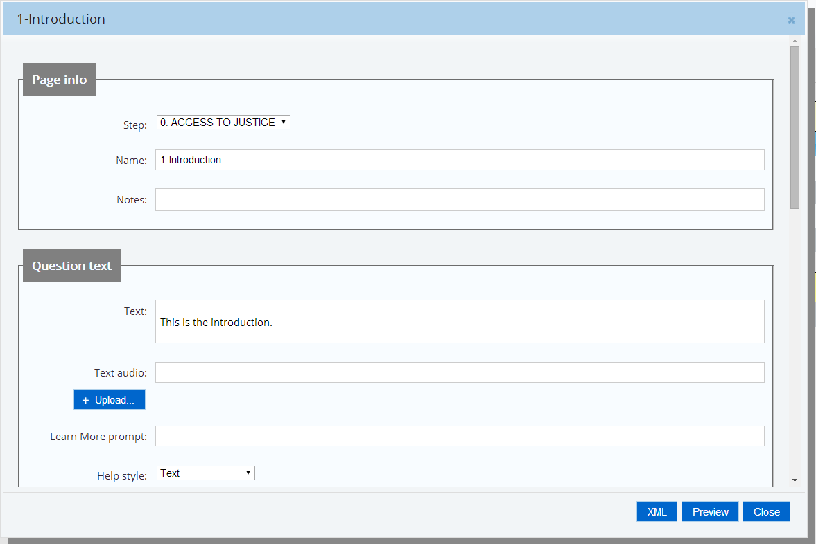
Question Design Now: Scroll to See it All- Screen 1
Question Step & Name
Add notes
Question Text
Add Audio

Slide 8
Question Text Extras
Add Pop-Ups
Embolden Text
Add a hyperlink to external websites
Italicize Text
Notes:
Only displays when you click into the field to edit it
Can’t change the font type/color/size
A clean, simple interface is A2J’s goal

Slide 9
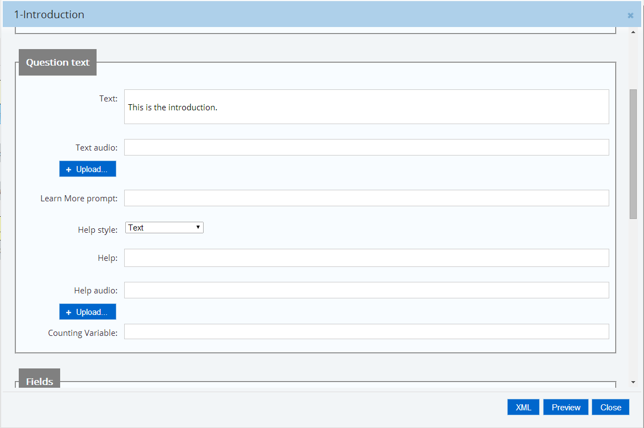
Question Design Now: Scroll to See it All- Screen 2
Choose Text, Show Me Graphic, or Show Me Video
Learn Question (Prompt)
Learn More Answer (Help)
Add Audio
Repeat Loop Counting Variable

Slide 10
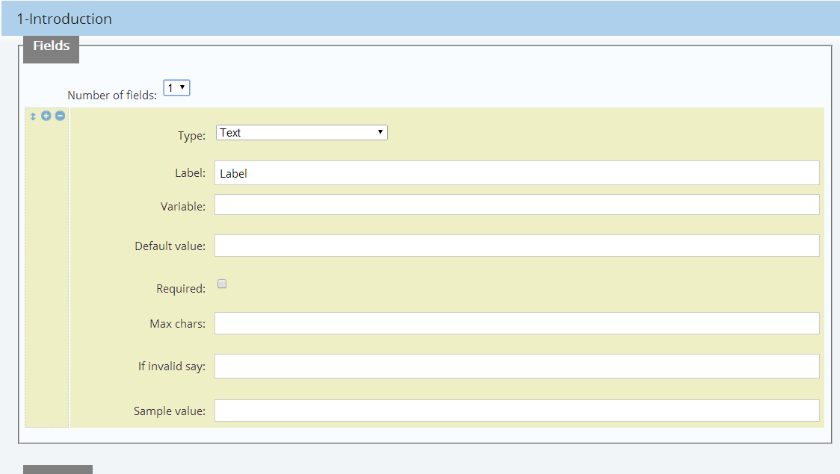
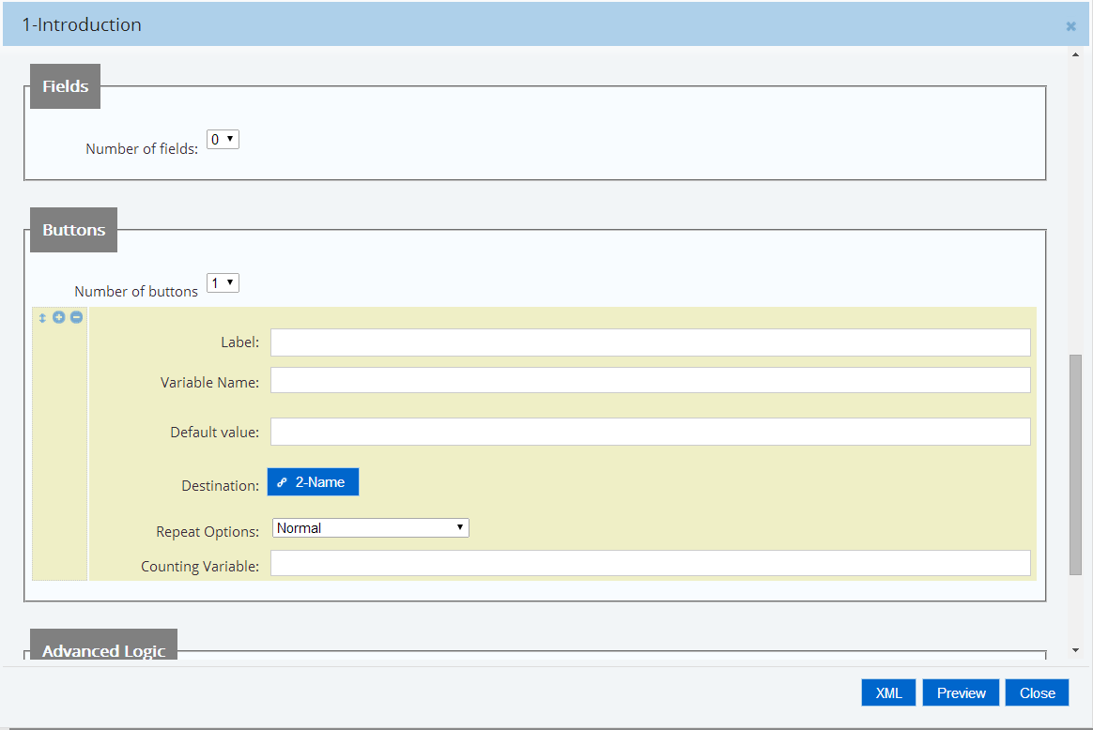
Question Design Now: Scroll to See it All- Screen 3
# of fields
Field Type
Field Label
Add & Delete Fields
Variable
Require Question
Prompt for Required Questions
Sample Value
Notes:
Field section is blank until you select 1 or more fields to fill in. Once you do that (Pop out next animation)
Explain sample value

Slide 11
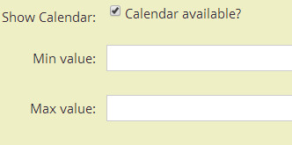
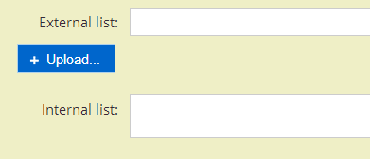
Fields Section Explained
“Label” appears before the field in the question text
You can assign default values for variables
Ex. Auto fill in your state or county
Limit value ranges for numbers
Ex. DOB- limit maximum year to 1914 and minimum year to 2014 or TODAY
Show a calendar for dates
Include internal and external lists
Require the user to fill in the answer

Slide 12
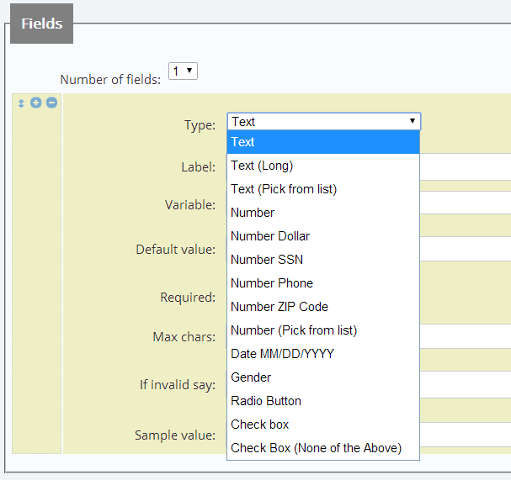
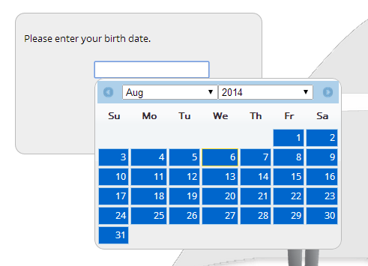
Field Types
Notes:
We’re still working on adding in the field templates that you used in 4.0 What are fields?
The format of the answer that an end user provides.
Six basic categories of field types available:
Text
Number
Date
Gender Fields
Radio Buttons
Check Boxes

Slide 13
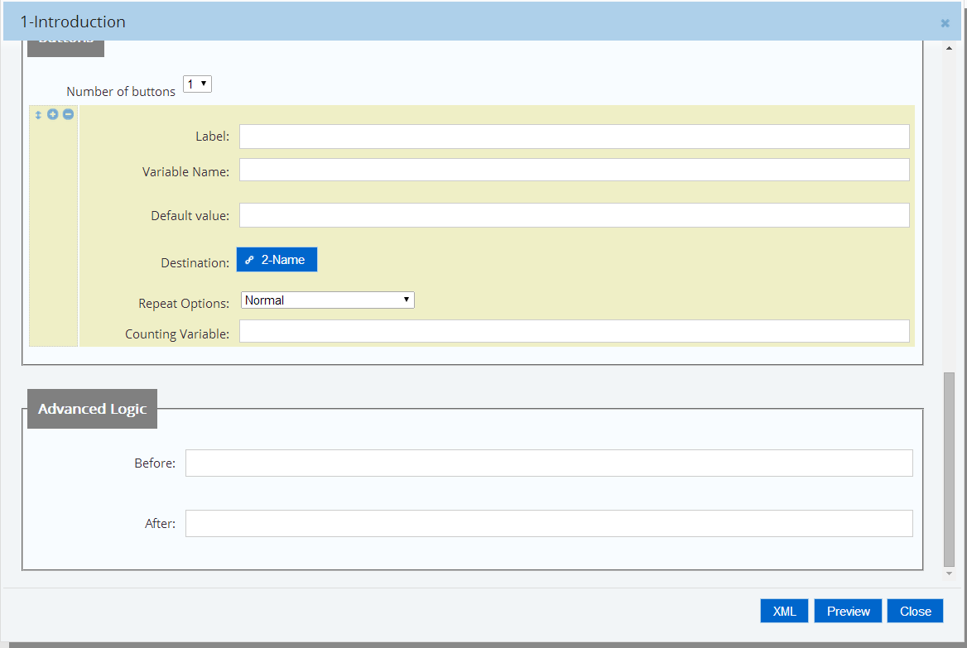
Question Design Now: Scroll to See it All- Screen 4
Add & Delete Buttons
Assign a Variable a Value
Destination Question on Button Click
Repeat Loop Options

Slide 14
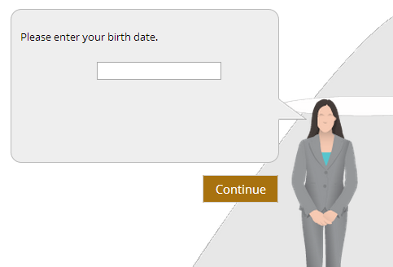
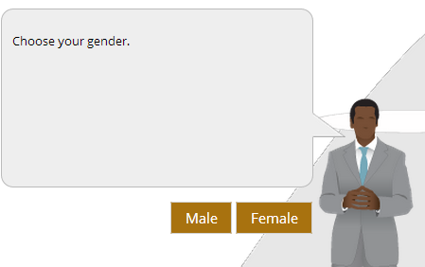
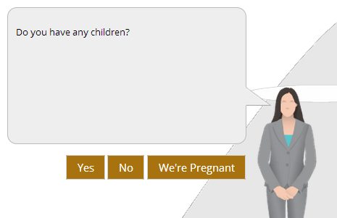
Getting to Know the Buttons Section
New questions by default only have the continue button
Use buttons instead of fields for questions with 3 options or less
Maximum number of buttons per question = 3
Label the buttons however you like

Slide 15
What Can a Button Do?
Assign a value to a variable
Go to another question
Ex. Next, Previous, or Jump Ahead
Sequentially move on
Set or increment a counting variable
Select “Destination Question” from drop down list of:
Other questions you made
Back to prior question
Success- Process Form
Exit functions
Exit user to a website

Slide 16
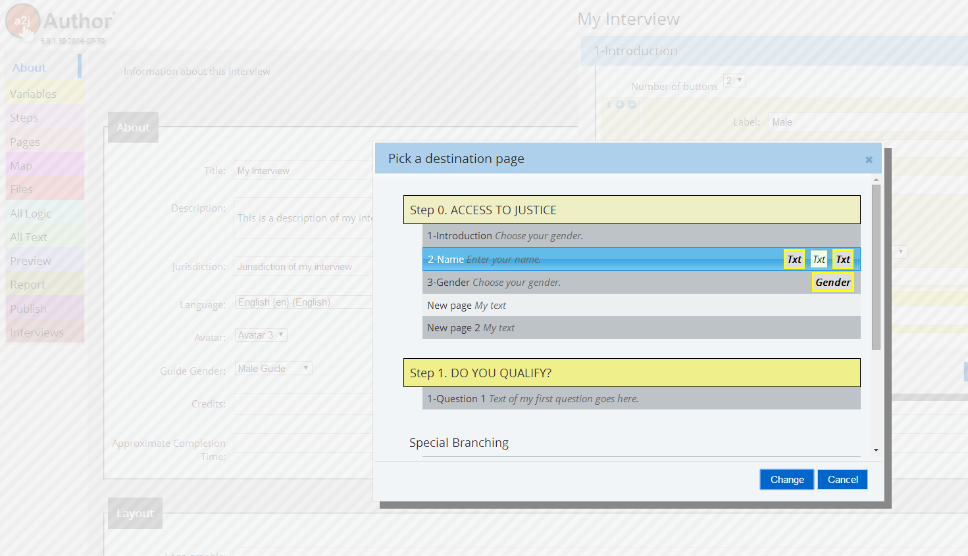
Buttons to Select Destination Question
Select “Destination Question” from drop down
Select from:
Other questions you made
“Back to prior question”
“Success – Process Form”
Exit functions
Can Exit user to a website

Slide 17
Advanced Logic
Write IF/ELSE statements
Test before user presses button or after user presses button
Notes:
Go to a2jauthor.org for more information on the advanced tab, also look for a future training on it. Too advanced for basic question design

Slide 18
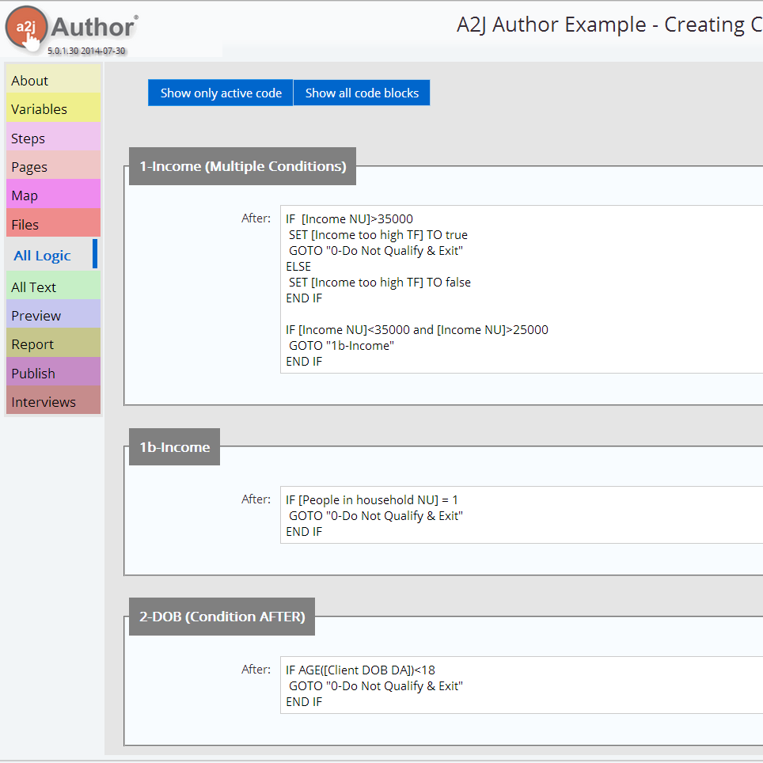
All Logic
Notes:
List of all your advanced conditions

Slide 19
Learn More About Question Design
www.a2jauthor.org
The A2J Authoring Guide 5.0
(Chapters 1-6 available now)
Screen shots to walk you through everything we discussed today
Available on our website: www.a2jauthor.org
Recorded Trainings & Presentations
www.youtube.com/a2jauthor

Slide 20
Questions?
Jessica Bolack Frank
Program Coordinator
jbolack@kentlaw.edu
312-906-5331

